Slide 1
GCP Networking 101
ACE Solutions Architecture Team

Slide 2
GCP Hierarchy
Company
Organization
Team A
Product 1
Team B
Dept 1
Product 2
Dept 2
Folders
P1
P2
P3
P4
Px
Py
Projects
R1
Rn
Resources
Notes:
on certain points we can see similarities among the constructs used by each CSP.
Starting from the bottom,
You have Resources, such as VMs.
Resources are inside a Project
Project is the top-level organization
Resources that are in one Project have NO access to resources in another project UNLESS you use 1 of 2 methods:
Shared VPC
VPC Network Peering
Folders are logical constructs like Resource Group in Azure.

Slide 3
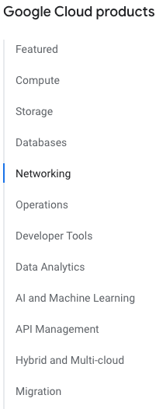
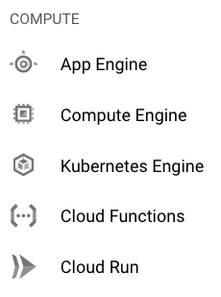
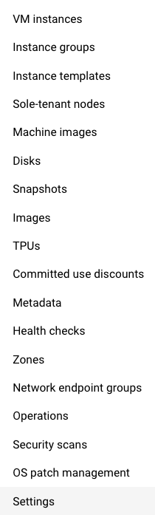
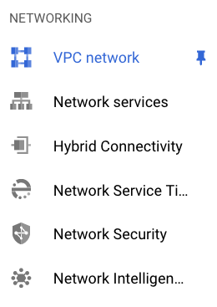
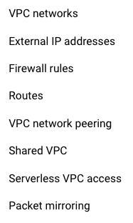
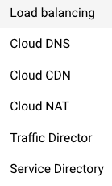
GCP Products and Services
Notes:
Similar to AWS and Azure, you have the concept of Services
VM is a resource
Disk is a resource
Constructs

Slide 4
GCP Important Services/Resources
Name | Purpose
Virtual Machine | Run instances (virtual machines)
Cloud IAM | Identity and Access Management
VPC/Subnet | Virtual Private Cloud
Cloud Storage | Storage
Interconnect | Connecting On-Prem
Google Cloud DNS | DNS
Cloud Load Balancing | Leverage close entry points to Cloud Backbone
Cloud CDN | CDN
Notes:
Cdn is all about getting contents closer to the users and caching it.

Slide 5
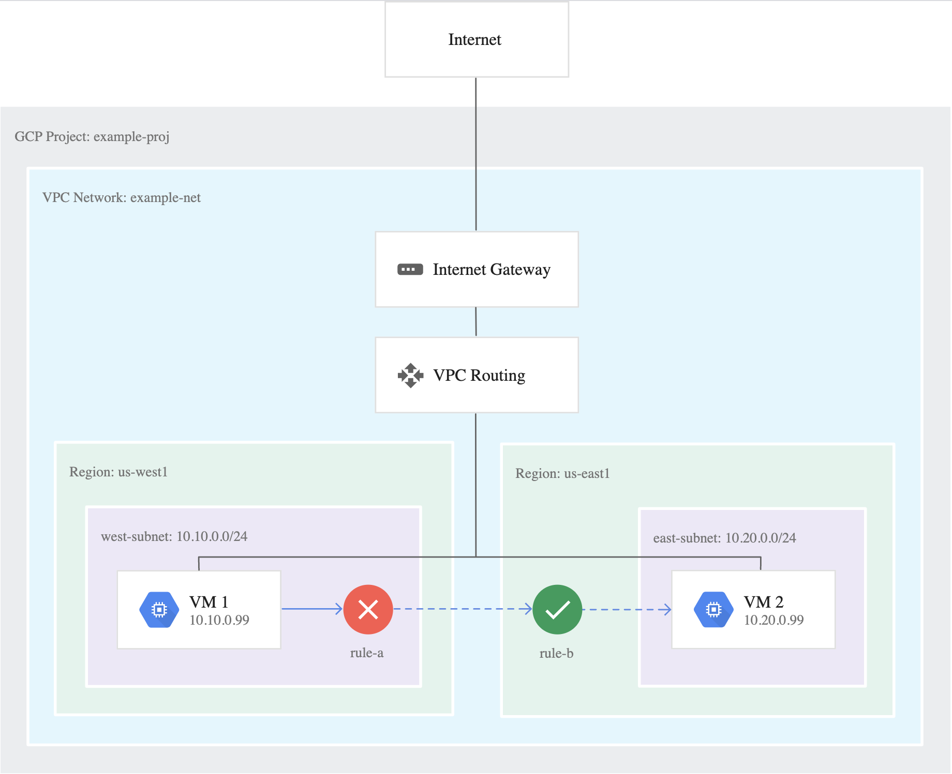

Slide 8
Notes:
Whenever you create a vpc, there is a concept of a global vpc.
In aws and likewise in azure, the vpc/vnet is a regional construct.
Whereas the vpc in gcp spans across different regions: it’s a global construct.
In this example the vpc “example-net” is deployed across the globe.
In gcp you define a subnet and then you specify to what region that subnet belongs to.
In this example based on this global construct, the vm in region us-west1 can communicate with the vm in us-east1 and viceversa, because they belong to the same VPC.
There is full routing between these two regions without leveraging any sort of peering: the communication is allowed by default because of the nature of the vpc itself.

Slide 9
Notes:
On top of that, you can create rules that impose how the traffic can flow among the subnets within the same vpc.
These rules are stateful and attached to the network interfaces. The goal here is in somehow segment or microsegment.

Slide 10
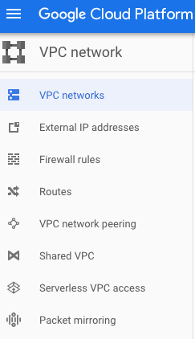
VPC Network and Subnets
VPC networks don’t have a top level CIDR associated with them (IP ranges are defined at subnet level)
VPC networks consist of one or more subnets
VPC Subnets can be created in
Auto Mode (creates subnets in each region automatically)
Custom Mode (VPC networks start with no subnets)
You can create more than one subnet per region
VPC Name
VPC Name | Region | Subnets | Mode | IP address ranges | Gateways | Firewall Rules | Global dynamic routing
vpc-network2 | asia-east2 | vpc-network2-subnet1 | Custom | 10.39.39.0/24 | 10.39.39.1 | 0 | On
Default | us-central1 | Default | Auto | 10.128.0.0/20 | 10.128.0.1 | 6 | Off
Notes:
Unlike AWS, VPCs don’t have any IP address range associated with them.
You don’t have a high-level VPC-level CIDR block.
Instead, IP ranges are defined at the subnet level.
There are 2 ways for creating the subnets:
Auto mode
Automatically create subnets in each region
Are easy to set up and use. Good for POCs and testing. But they might overlap with your on-prem.
Custom mode
However, custom mode VPC networks are more flexible and are better suited to production.
You can switch a VPC network from auto mode to custom mode. This is a one-way conversion; custom mode VPC networks cannot be changed to auto mode VPC networks.

Slide 11
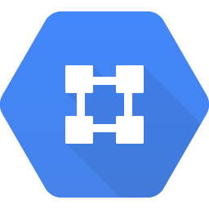


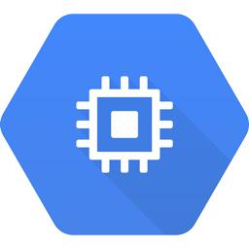


Basic GCP Networking Components
GCP Regions and Zones
VPC /Subnets
VPC Peering
Implicit Routing
VPN Gateway: Used to connect to your on-prem. Only supports BGP
VPCs can be peered
Not transitive
Requires full mesh
Project Prod
On Premises
GCP Global VPC
Subnet
Subnet
10.10.0.0/26
10.50.0.0/26
VM (us-west1-a) Zone
VM (us-east1-a) Zone
In AWS: VPC is regional, subnets are zonal
US West
US East
In GCP: VPC is global, subnets are regional
Internet
Notes:
Unlike AWS, VPCs don’t have any IP address range associated with them.
You don’t have a high-level VPC-level CIDR block.
Instead, IP ranges are defined at the subnet level.
There are 2 ways for creating the subnets:
Auto mode
Automatically create subnets in each region
Are easy to set up and use. Good for POCs and testing. But they might overlap with your on-prem.
Custom mode
However, custom mode VPC networks are more flexible and are better suited to production.
You can switch a VPC network from auto mode to custom mode. This is a one-way conversion; custom mode VPC networks cannot be changed to auto mode VPC networks.

Slide 12
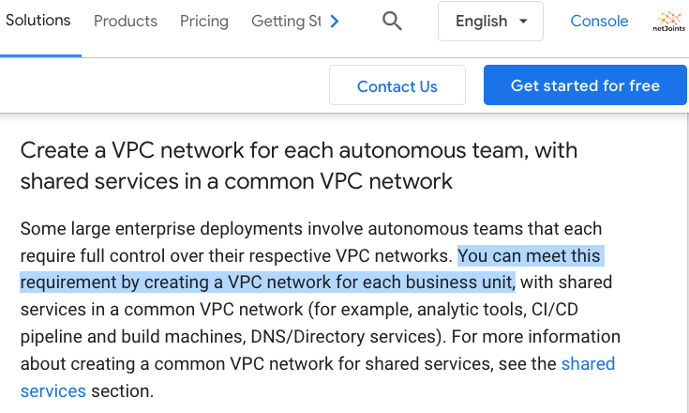
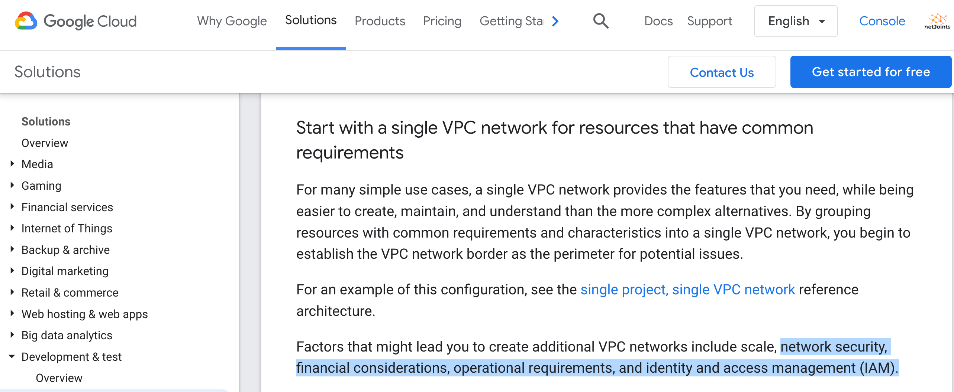
GCP VPC Design Best Practices
Create multiple region-bound VPCs
For proper segmentation
Encryption
Service Insertion
The Aviatrix transit combined with regional VPCs is the recommended approach
Source: https://cloud.google.com/solutions/best-practices-vpc-design

Slide 13
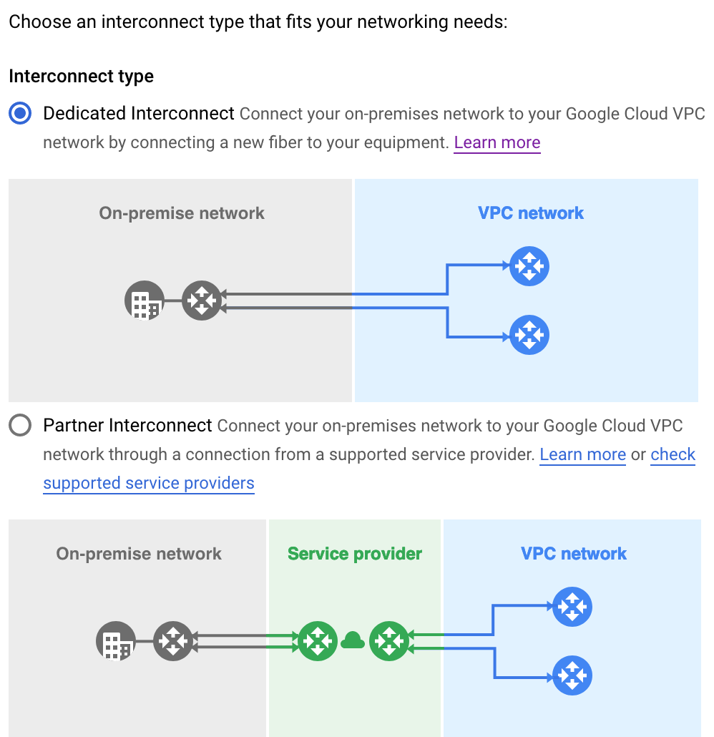
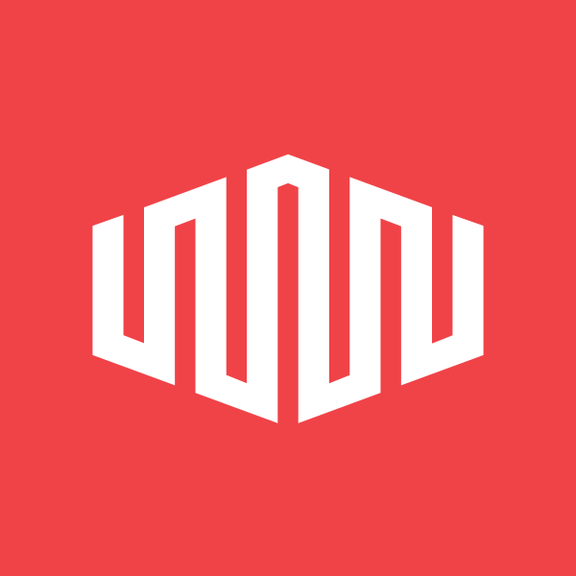
Cloud Interconnect
Connect on-prem network to VPC network through a private circuit
Two types of Cloud Interconnect
Dedicated Interconnect
Meet GCP network in a colocation facility
10 Gbps or 100 Gbps pipes
Partner Interconnect
Connect to service providers that connect directly to Google
50 Mbps to 50 Gbps
Layer 2 or Layer 3 connections are supported
Both support multiple VLAN attachments for redundancy
Encryption limited to 1.25 Gbps without Aviatrix
Notes:
Cloud interconnect is the equivalent of expressroute and directconnect.
In gcp, this is the way to reference the private connection from your own prem to gcp.
There are two methods for implementing a cloud interconnect:
1) dedicated interconnect: in a nutshell, a direct fiber that branches off from your on-prem towards the gcp infrastructure or to the colocation facility
2) The second method is used when you don’t have access directly to your on-prem network or you do not have a colocation nearby that you can utilize, therefore you connect your on-prem network toa service provider network ( a partner ).
These connections are not encrypted !

Slide 14
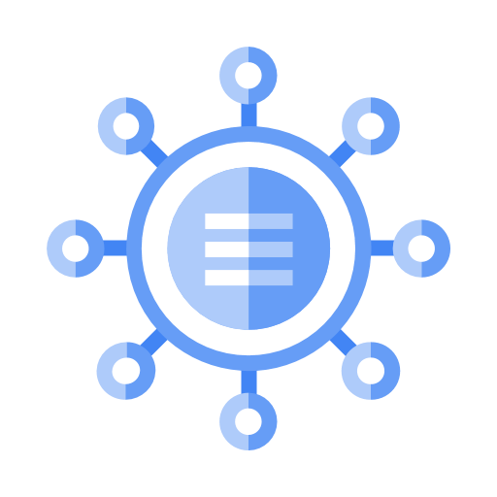
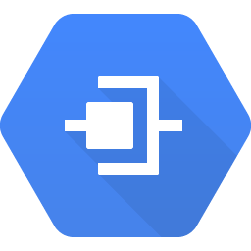
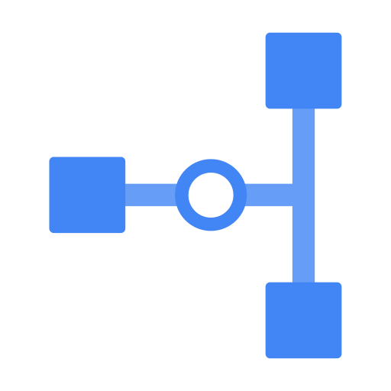

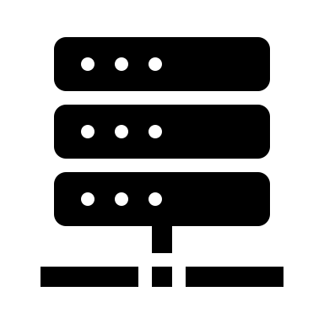



Network Connectivity Center (NCC)
What is it?
A hub and spoke model where the hub is a Google construct consisting of at least one cloud router and spokes
Spokes can be Cloud Interconnect circuits, Cloud VPN connections or third-party virtual instances (called Router Appliances)
Limitations
The same VPC network must connect all spokes to the hub
No multi-cloud support
Network Connectivity Center Hub
Spoke A
Spoke B
Spoke C
Spoke D
Interconnect
(dedicated)
VPN
Partner
Appliance
Interconnect
(Partner)
Equinix
Remote Site
Branch
Corp HQ
Notes:
As we saw before with Virtual wan, this is a hub architecture where all the vpcs can be hooked up.
Actually, everything can be pluged to the NCC.
The ncc WILL DO ANY-TO-ANY routing among all of these components.
Obviously, the big limitation is no multi-cloud support.
If you are moving across clouds, there is not solution here. In addition to this though, because this is a managed service, there are tons of limitations, such as lack visibility and troubleshooting in what is happening inside the ncc hub

Slide 15

GCP Shared VPC
Use case
Centralize the control of network resources like subnets, routes, and firewalls.
Improve the security by restricting network resource control to only network teams.
A Shared VPC is a VPC defined in a host project
A shared VPC network is shared in a service project (tenant project)
Technique for providing networking services to tenant VPCs
A Service Project is a project that has been attached to a host project
A Shared VPC Admin gives its VPC or subnet to the Service Project
All VPCs must be in the same organization
Each service project can only be attached to a single host project
Shared VPC is not a transit replacement
Shared VPC has no Control Plane or Data Plane → IAM construct
“Shared VPC” is not equal to “Shared Services VPC”
It is not necessarily meant to be hosting shared services in the shared VPC
Prod Service Project
Dev Service Project
Shared VPC Prod
Shared VPC Dev
Prod VMs
10.21.11.0/24
Dev VMs
10.21.12.0/24
useast4
useast4
AVTX SPK-GW
AVTX SPK-GW
Local VPC Transit
AVTX TR-GW 10.21.4.0/24
ASN:65941
Central IT Host Project
Notes:
Shared VPC
The admins of the Host project own network resources: subnets, routes, firewall rules, etc.
They can define approved subnets that the service projects can use.
Service Project
A service project ←→ a team/BU/department etc.
Service project admins own workloads: VM, GKE, LBs, etc. No access to network config.
Workloads of different service projects can communicate via the Shared VPC.

Slide 16
Next: OCI Networking 101

